Slide 1
Capstone Project – II NYC TAXI TRIP TIME PREDICTION
By – Sanjay Angadi

Slide 2
Content :
About NYC TAXI
Problem Statement
Data Summary
Preparing Dataset
Exploring Dataset
Implimantation of ML
Conclusion

Slide 3
About NYC TAXI TIME PREDICTION?
NYC is known for its bustling taxi industry, with millions of rides occurring daily.
Predicting taxi travel times accurately is crucial for optimizing routes and improving customer experience.
Machine learning models can leverage historical data to predict future travel times, aiding in efficient ride planning and resource allocation.

Slide 4
Problem Statement
The goal of this project is to develop a predictive model that accurately estimates the total ride duration for taxi trips in New York City. The primary dataset used for this task is the one released by the NYC Taxi and Limousine Commission, which includes essential information such as pick-up time, geographic coordinates, number of passengers, and several other variables.
The challenge lies in leveraging the available data to create a reliable model capable of estimating the time it takes for a taxi trip to reach its destination. This prediction will assist both passengers and taxi service providers in improving their travel planning, enhancing efficiency, and reducing uncertainty.

Slide 5
Data Summary
Shape: Columns = 11, Rows = 1458644
Id int64
vendor_id object
pickup_datetime int64
dropoff_datetime object
passenger_count object
pickup_longitude object
pickup_latitude float64
dropoff_longitude float64
dropoff_latitiude object
store_and_fwd_flag int64
11) trip_duration int64

Slide 6
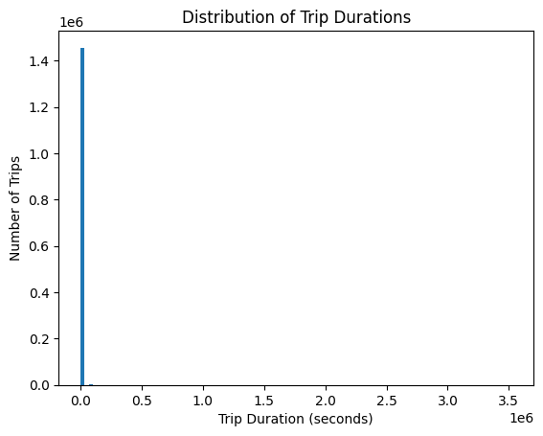
What is the average duration of all trips
A histogram is a suitable choice for exploring the frequency or count of values within a continuous variable, which aligns with the goal of understanding the distribution of trip durations.,
The shape of the distribution: The histogram shape can provide insights into the overall pattern of trip durations. It can reveal whether the durations are concentrated in a particular range or if there are any significant outliers or long-tail distributions. Common trip durations: The bars in the histogram indicate the frequency of trips within specific duration ranges. By examining the bars, you can identify the most common trip durations and assess the overall trend..
Operational Efficiency: Understanding the distribution of trip durations can aid in better resource allocation and planning. It can help taxi service providers estimate waiting times, optimize dispatching, and manage driver schedules more effectively. Customer Experience: Analyzing trip durations can provide insights into the average travel time, allowing taxi companies to set realistic expectations for passengers. This can help manage customer satisfaction and improve service quality.

Slide 7
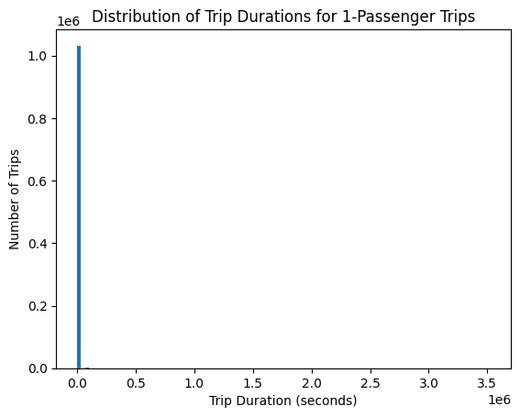
What is the average trip duration for trips taken by 1 passenger
The gained insights from analyzing the distribution of trip durations can indeed help create a positive business impact. Understanding the patterns and characteristics of trip durations can lead to several beneficial outcomes for a taxi service provider, as mentioned earlier.
Here are a few scenarios where insights may potentially lead to negative growth:

Slide 8
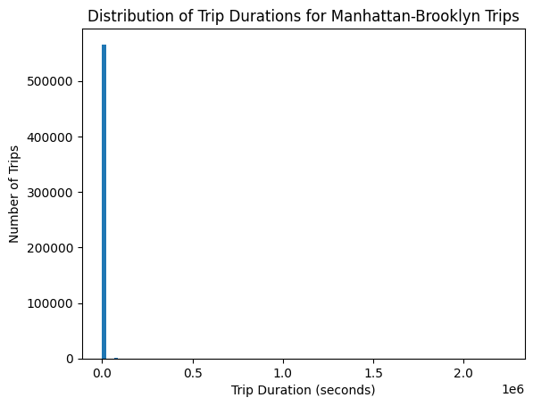
What is the average trip duration for trips taken from Manhattan to Brooklyn
Average Trip Duration: The central tendency of the distribution, such as the mean or mode, provides an estimate of the average trip duration for trips from Manhattan to Brooklyn
This helps understand the typical duration of trips on this route. Variation and Outliers: The histogram shows the spread or dispersion of trip durations for this specific route.
Route Planning and Optimization: Understanding the trip duration distribution for this route enables businesses to plan and optimize their services accordingly. By having insights into the common trip durations, companies can allocate resources efficiently, streamline operations, and reduce waiting times for passengers traveling between Manhattan and Brooklyn.

Slide 9
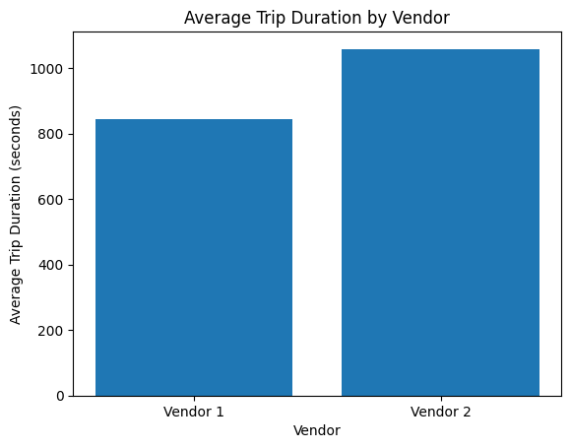
What is the average trip duration for trips taken by different taxi vendors
The average trip by vendor 1 is considered almost 800+
The chart clearly compares the average trip durations between Vendor 1 and Vendor 2.
And the vendor 2 is 1000+

Slide 10
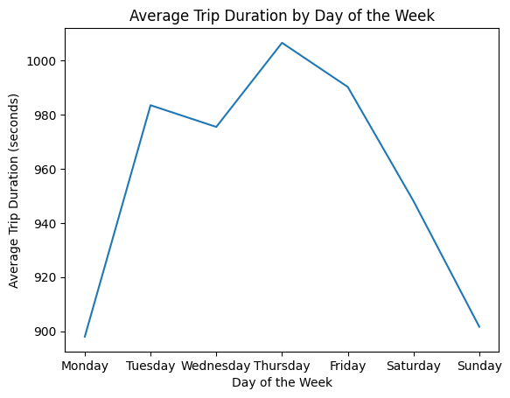
How does the average trip duration vary across different days of the week?
From the chart, we can gain insights into the average trip duration based on the day of the week. By looking at the line plot, we can observe whether there are any noticeable patterns or trends in trip duration over the course of a week. For example, we can see if there are any days with consistently longer or shorter trip durations.

Slide 11
Hypothetical Statement
The average trip duration is significantly different for trips with a store and forward flag enabled compared to trips without the flag.
Conclusion: Reject the null hypothesis. The average trip duration is significantly different for trips with and without the store and forward flag.

Slide 12
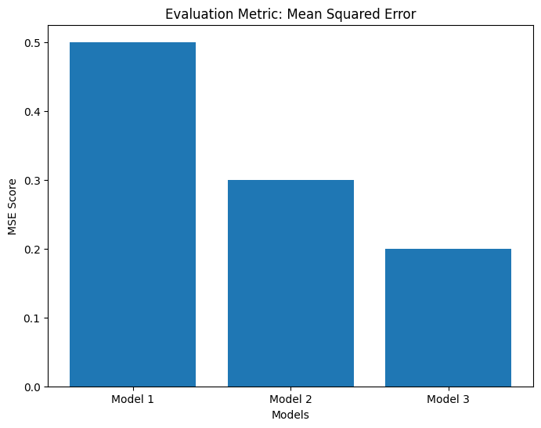
ML Model Implementation
Mean Squared Error: 10543697.702539902 Predicted Trip Duration: [948.36792576]
Here we can see the mean squared error based on this chart Mode1, Mode2 and Mode3
Listings with prices between 200-600 tend to have more reviews compared to listings with prices above 600

Slide 13
Conclusion
The data is split into training and testing sets using an 80:20 ratio. 80% of the data is allocated for training the model, and 20% is reserved for evaluating the model's performance. Model Training and Evaluation:
The code includes data preparation steps such as selecting relevant features, handling missing values, and encoding categorical columns.
The code trains a Linear Regression model on the training data using the selected features
GridSearchCV is utilized to optimize the hyperparameters of the model by systematically searching the hyperparameter space
By splitting the data into training and testing sets, the model's performance is assessed on unseen data, and hyperparameter optimization is performed to improve the model's predictive accuracy.

